Slide 1
COLOR BALANCING from:2015 cad contest
Group:1
Group member:徐宇霆、蔡宇軒、林裕洲
Date:1/4

Slide 2
Agenda
Color Balancing purpose
Project procedure
Project result
Reference

Slide 3
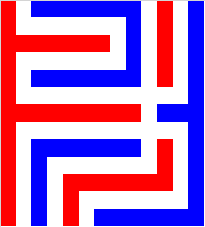
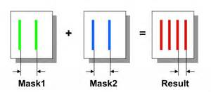
Color Balancing purpose
During IC manufacturing, the design of mask
The limitation of light, resolution
Double Patterning

Slide 4
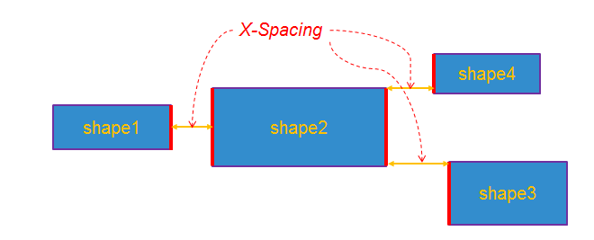
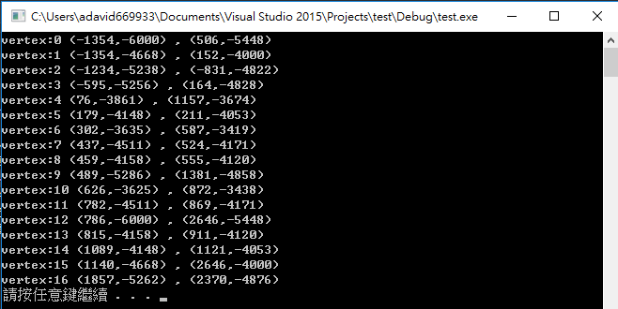
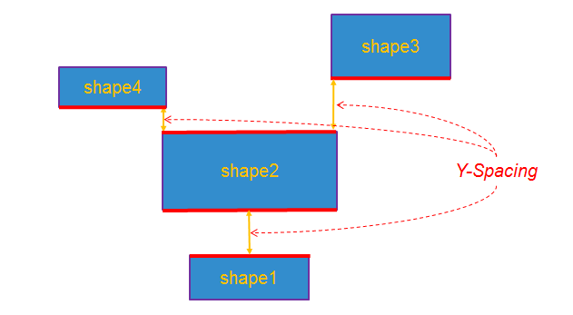
Project procedure
a. Map to graph
vertex and edge

Slide 5
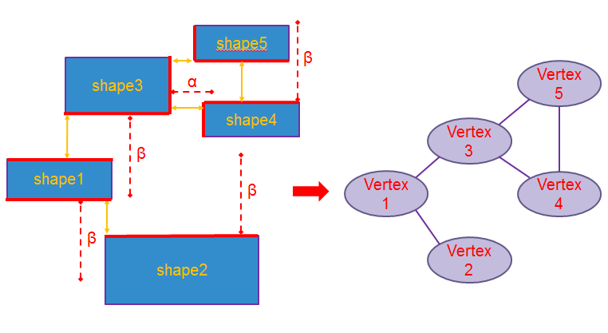
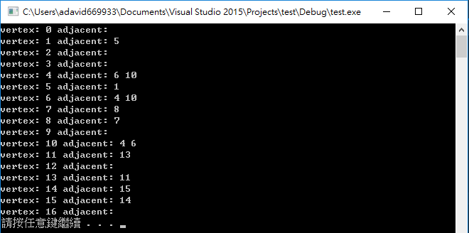
Project procedure
b. Build the graph

Slide 6
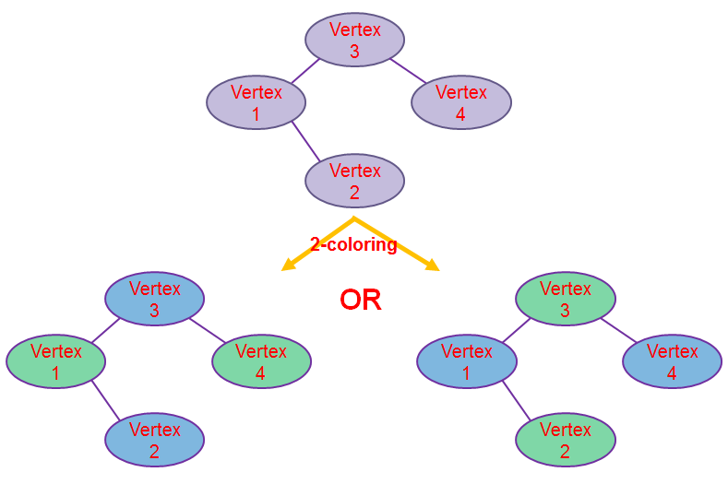
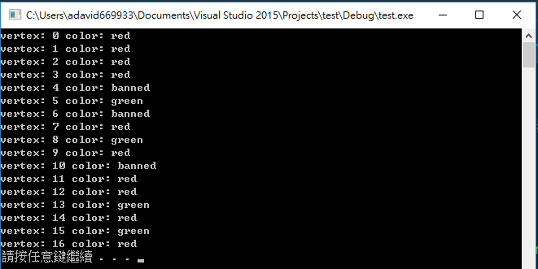
Project procedure
c. Assign color

Slide 7
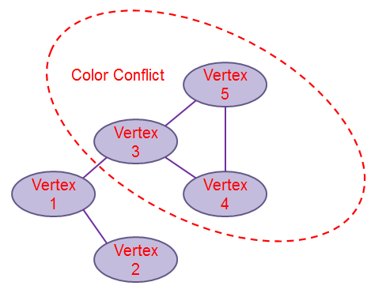
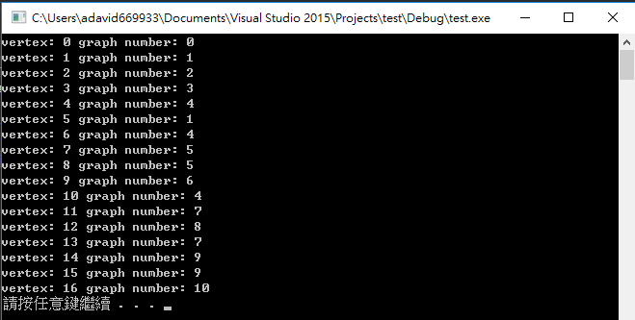
Project procedure
d. Take out invalid graph

Slide 8
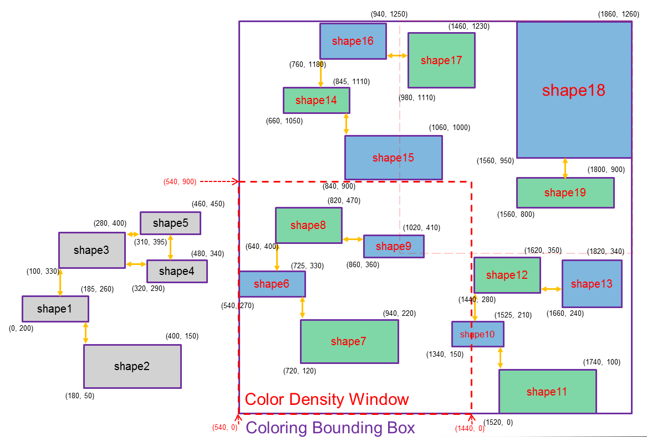

Project procedure
e. Determine color
Bounding Box

Slide 9
Problem definition

Slide 10
Problem definition
Cutting the bounding box into several windows.
At Each window, the differential color density is defined as differential area of red and green shapes divided by the window area.
Total score is defined as
100-0.2*Σ(differential color density)
=100-0.2*Σ|red area – green area|/ window area
→ minimize Σ|red area – green area|

Slide 11
How to draw the colors?
Σ|red area – green area|

Slide 12
Preparation for drawing
We cannot add the differential area of different windows, i.e.
|A|+|B|≠|A+B|, so we consider only one window at a time.
Graph 1
window
Graph 2
Graph 3
Σ|red area – green area|

Slide 13
Preparation for drawing
Graph1: red-green | Graph2: red-green | Graph3: red-green
Graph 1
window
Graph 2
Graph 3
Σ|red area – green area|

Slide 14
Preparation for drawing
Differential area of a window
=
Graph1: red-green
+
Graph 2: red-green
+
Graph 3: red-green
Graph 1
window
Graph 2
Graph 3
Σ|red area – green area|

Slide 15
Preparation for drawing
Differential area of a window
=
±
Graph1: red-green
±
Graph 2: red-green
±
Graph 3: red-green
Graph 1
window
Graph 2
Graph 3
Σ|red area – green area|

Slide 16
Preparation for drawing
Differential area of a window
=
±
Graph1: red-green
±
Graph 2: red-green
±
Graph 3: red-green
±1
±1
±1
=
Graph1: red-green | Graph2: red-green | Graph3: red-green
×
Σ|red area – green area|

Slide 17
Preparation for drawing
Color vector
Area matrix
 | Graph 1 | Graph 2 | Graph 3
Window 1 | red-green | red-green | red-green
Window 2 | red-green | red-green | red-green
… | …
Window n | red-green | red-green | red-green
a1
a2
…
an
±1
±1
±1
×
=
Σ|red area – green area|

Slide 18
Algorithm of drawing colors

Slide 19
Problem redefinition
For a given matrix A, how to construct a column vector X whose value is either 1 or -1, so that the value Σ|(AX)i| would be the minima?
 | Graph 1 | Graph 2 | Graph 3
Window 1 | red-green | red-green | red-green
Window 2 | red-green | red-green | red-green
… | …
Window n | red-green | red-green | red-green
a1
a2
…
an
±1
±1
±1
×
=
→ minimize Σ|ak|

Slide 20
Problem redefinition
For a given matrix A, how to construct a column vector X whose value is either 1 or -1, so that the value Σ|(AX)i| would be the minima?
 | Graph 1 | Graph 2 | Graph 3
Window 1 | red-green | red-green | red-green
Window 2 | red-green | red-green | red-green
… | …
Window n | red-green | red-green | red-green
a1
a2
…
an
±1
±1
±1
×
=
→ minimize Σ|ak|
Optimization problem → SA algorithm

Slide 21
power of SA algorithm
The expectation value of the failure probability will exponentially decay while using linear execution time. More explicitly,
failure probability of testing one time = q
⇒ failure probability of testing n times = q^{n}
For example, if q = 99%, then testing 70 times will lead to q⁷⁰ ≌ 50% !

Slide 22
power of SA algorithm
We use iteration = 500 for the reason that the answer is almost fixed after 500 iterations of SA.
The initial condition is randomly chosen at the beginning of each iteration for more chance to reach different answers.
The initial temperature and the temperature decreasing ratio is set properly so that the probability of applying the change would be reasonable.

Slide 23
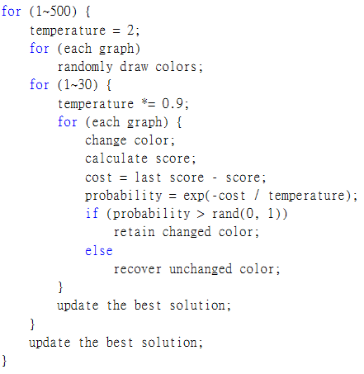
Pseudocode
Pseudocode

Slide 24
3 accelerating methods

Slide 25
3 accelerating method
Area matrix
Color vector
 | Graph 1 | Graph 2 | Graph 3
Window 1 | red-green | red-green | red-green
Window 2 | red-green | red-green | red-green
… | …
Window n | red-green | red-green | red-green
a1
a2
…
an
±1
±1
±1
×
=
2 method of acceleration:
Partial calculation
Using array instead of vector for faster calculations
Graph 2
red-green
red-green
…
red-green
a1
a2
…
an
+=
× (±2)

Slide 26

CUDA toolkit
Several time faster than the original one.

Slide 27
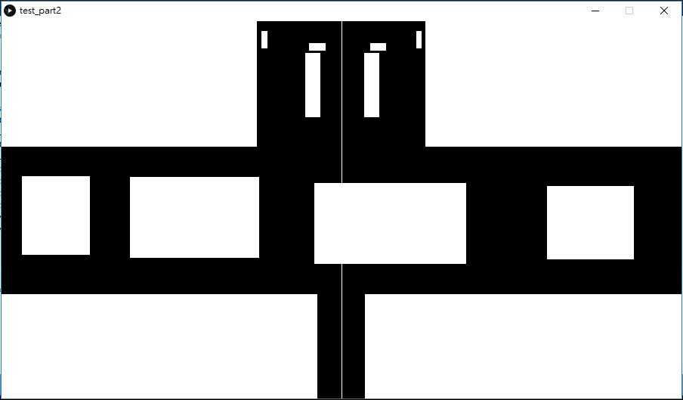
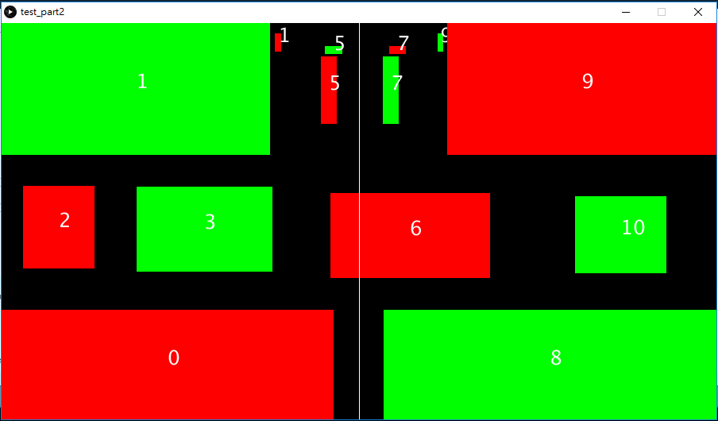
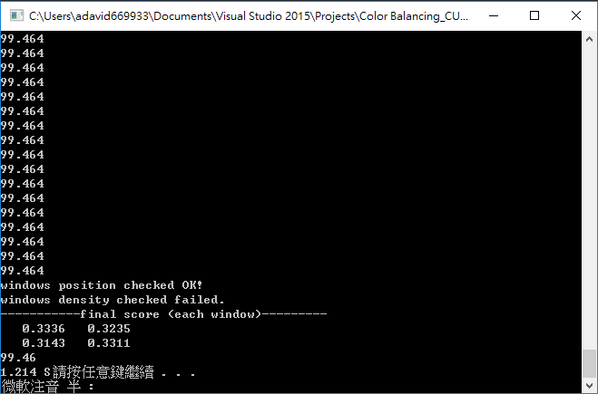
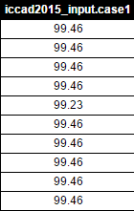
Project result

Slide 28
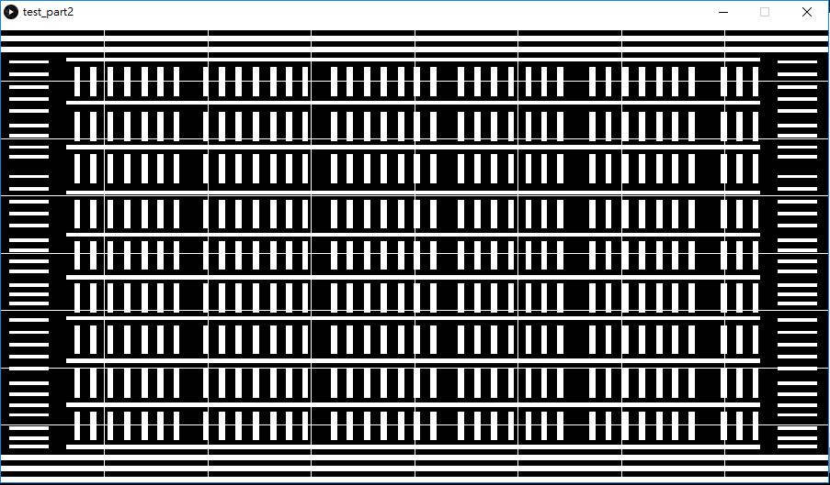
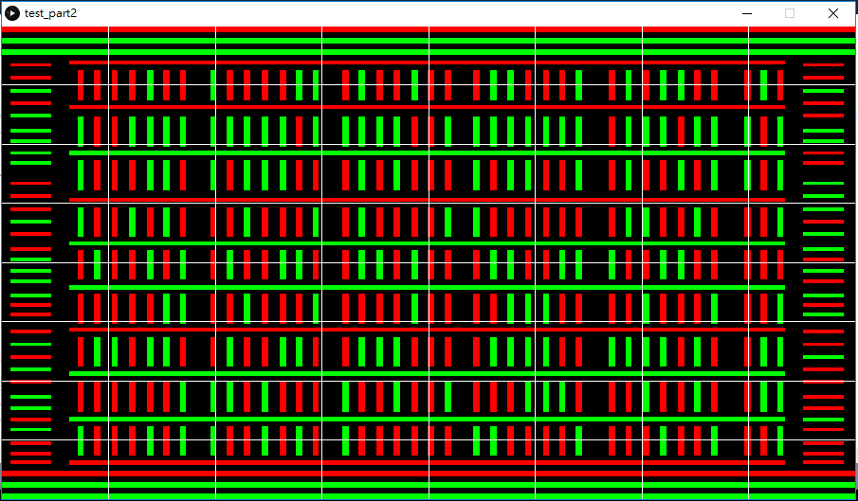
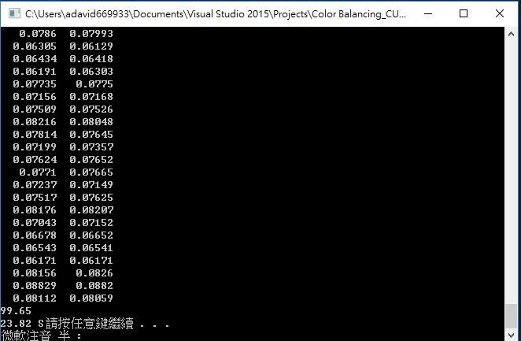
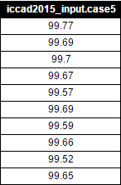
Project result

Slide 29
Reference
1. http://cad-contest.el.cycu.edu.tw/problem_E/default.htm
2.http://www.cs.cornell.edu/Courses/cs3110/2009sp/recitations/rec22.html
3. http://electroiq.com/blog/2009/08/double-patterning-design-challenges/
4.https://en.wikipedia.org/wiki/Multiple_patterning

Slide 30
Q&A

